Slide 1
Kick off Meeting
November 4/5, 2019
ID 01 - Framework for 3D printing in each EU partner Institution
Limerick Institute of Technology - Ireland

Slide 2
OBJECT
Perform a literature search and retrieve relevant documents from EU countries in the areas of 3D Printing
Produce a summary of retrieved domains,
Produce a summary of attached competencies and countries endorsement of 3D Printing on Libraries
will produce a rating sheet with potential 3D Printing education domains, applications in libraries and rating scales for all partners to be rated.
Produce the first 8 highest scored domains will be selected to develop 3D Printing competencies for education purposes

Slide 3
INTRODUCTION
Basic 3D printing workflow
OK?
Input data
Data
Processing
Data
printing
Y
N

Slide 4
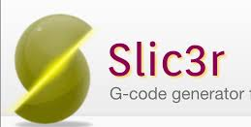
INTRODUCTION
Advanced 3D printing workflow
desktop
3D printing via PC
PERSONAL LOW COST
OFFICE ENVIRONMENT
3D printing via SSD
Scan 3D
input
process
output
PLY, OBJ
STL
AMF
3MF
VERIFICATION
REPAIR INFO
ORIENTATION
LOAD OPTIMIZATION
SIMULATION
3D printing via NET/PC
CAD design
G-CODE
GENERATION
SLICING OPS
PROFESSIONAL
3D printing via SSD
3D printing via NET/PC
MANUFACTURING
HIGH PERFORMANCE
3D printing via SSD
Open source
commercial

Slide 5
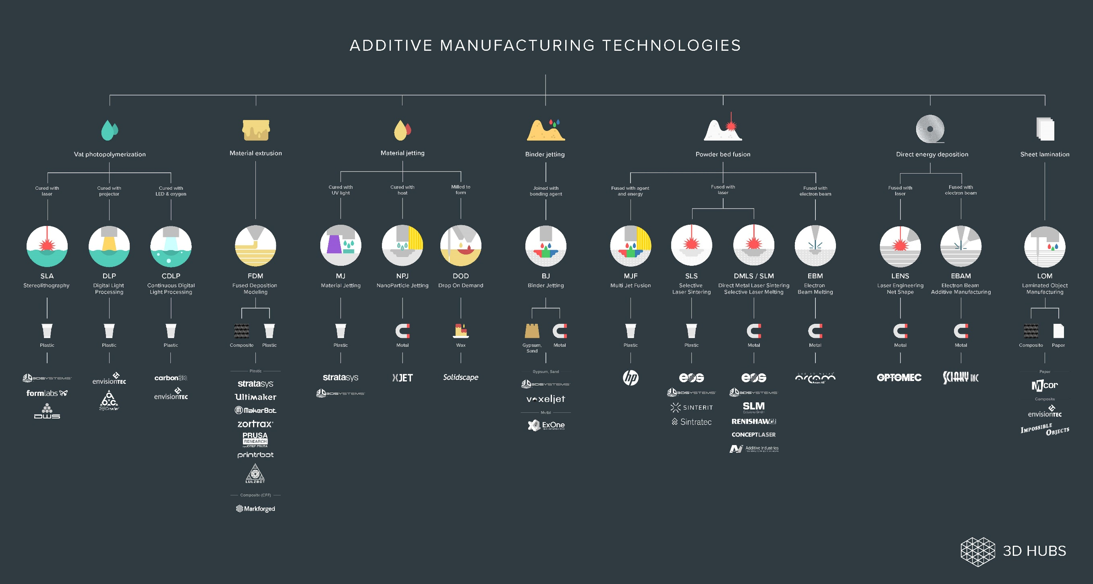

Slide 6
Competence, skills and attitudes
About the 3D printing technologies
Ability to select 3d printing technologies (2)
Ability to recognize technologies build size
Skills to recognize dimensional Accuracy on 3D printing technologies
Capacity to select between conceptual design, embodiment design (form, fit and function) or detailed design (1)

Slide 7
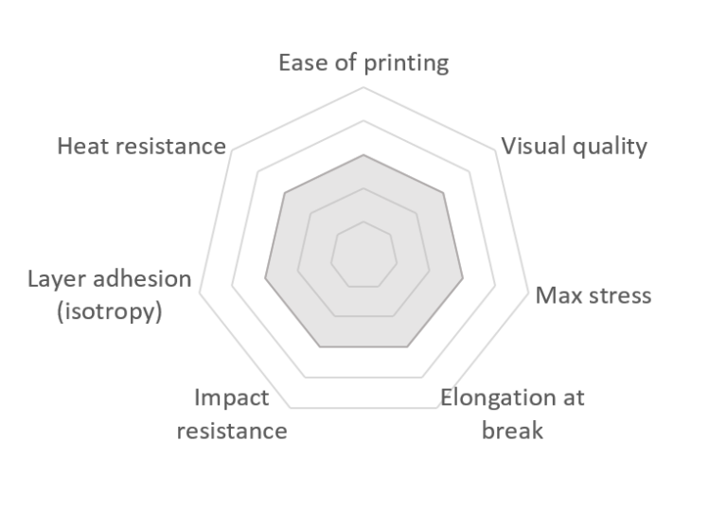
About the 3D printing materials
Source: https://www.3dhubs.com/knowledge-base/fdm-3d-printing-materials-compared/#methodology

Slide 8
Competence, skills and attitudes
About the 3D printing materials
Ability to select 3d printing materials (3)
Skill to recognize mechanical properties like ease of printing, Visual quality, Max stress, Elongation at break
Skill to recognize mechanical properties like Impact resistance, layer adhesion (isotropy), Heat resistance (4)
Ability to select Part accuracy
Skill to select Surface finish
Skill to select material post processing
Ability to select cold welding procedures

Slide 9
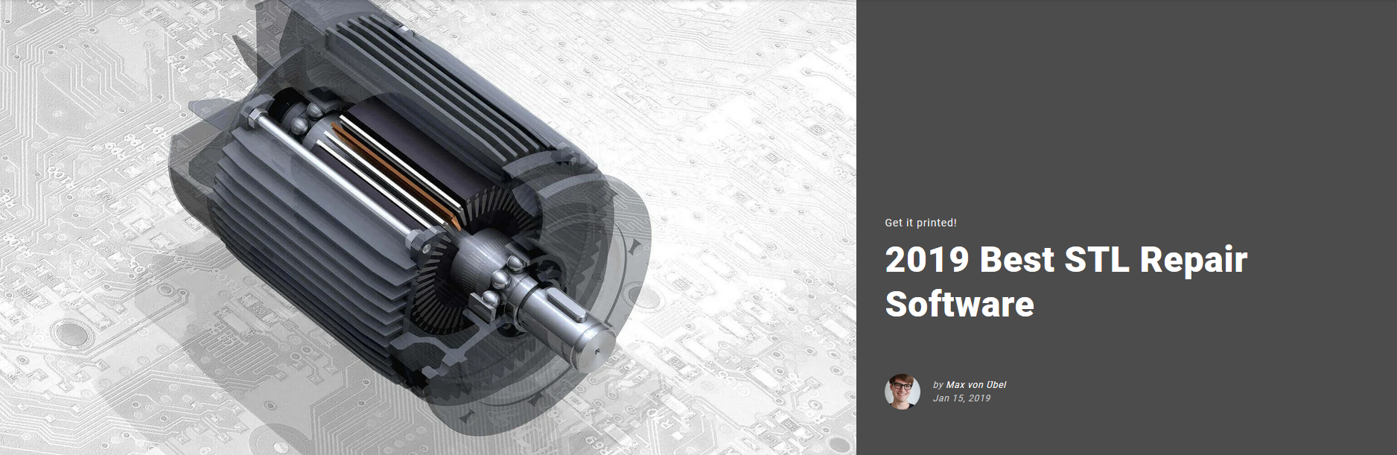
About the 3D printing process data
Source: https://all3dp.com/1/stl-repair-stl-file-online-checker-fix-3d-model/

Slide 10
Competence, skills and attitudes
About the 3D printing process data
Demonstrated ability to recognice STL, AMF, 3MF, PLY, OBJ input files (6)
Ability to recognize technologies estimation built time
Ability to use STL repairing software, Netfabb, Cura, Simplify3D, Slic2r, Pronterface, Repetier Host, Meshmixer, Meshlab, Magics, Deskartes. (10)
Skill to use slicing software Netfabb, Cura, Simplify3D, Slic2r, Pronterface, Repetier Host, Meshmixer, Meshlab, Magics, Deskartes. (10)
Skill to manage Print Quality Troubleshooting Guide (5)
Ability to recognize 3d printing glossary and terminology (7,8)
Skill to manage closed surfaces/solids (9)
Ability to use platform built simulators
Skill to manage booleans operations, symmetry, scaled, duplicated parts with dedicated software
Ability to programming printing parameters (Hotend diameter, slicing layer, skirt, dual printing, Hotend material selection, supports orientation, infill and form density )(11)

Slide 11
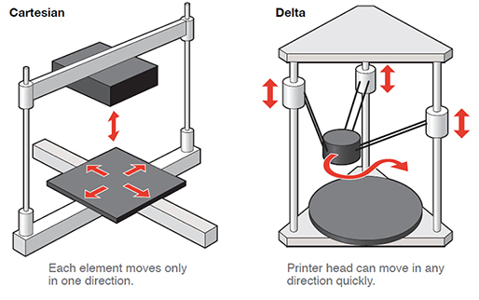
Competence, skills and attitudes
About the 3D printing layout
Source: http://www.samanthavanrijs.nl/2017/12/07/3d-printing-teens-6-building-3d-printer-xyz-axis/

Slide 12
Competence, skills and attitudes
About the 3D printing desktop layout
Ability to recognize technologies build size
Ability to recognize dimensional
Accuracy on 3D printing technologies
Ability to work with network printers or estandalone 3d printer
Skill to make 3d printer configurations
Skill to make 3d printer calibration
Attitude to built 3d printed part cost estimation
Attitude to solve print Quality troubleshooting (12)(13)
Skill to change 3d print materials

Slide 13
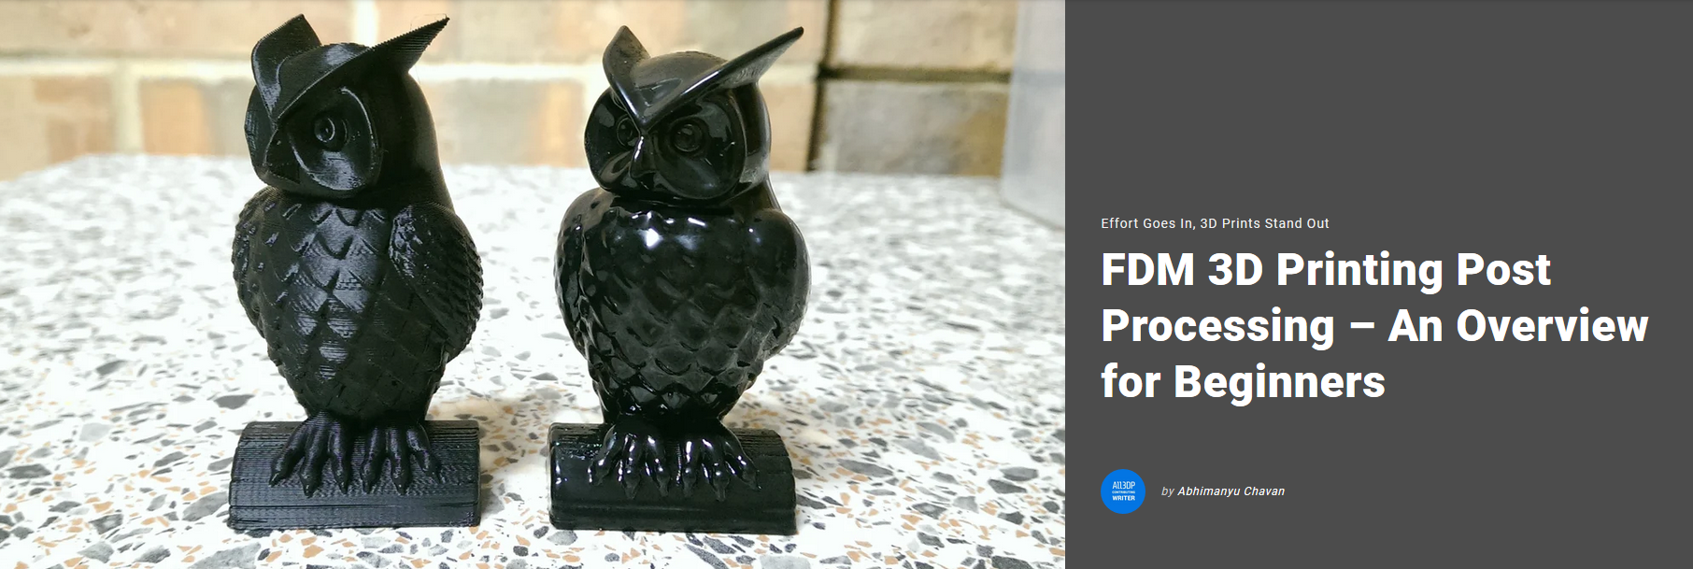
About the 3D printing post- processing
Source: https://all3dp.com/2/fdm-3d-printing-post-processing-an-overview-for-beginners/

Slide 14
Competence, skills and attitudes
About the 3D printing post- Processing
Ability to remove supports on printed parts (14)
Ability to clean printed parts
Skill to use electric cutting, cleaning parts
Skill to use soluble supports filaments (PVA, HIPS)
Ability to use sanding post Processing
Ability to use painting technique
Ability to use welding technique
Ability to use gluing technique

Slide 15
3D printers in libreries

Slide 16
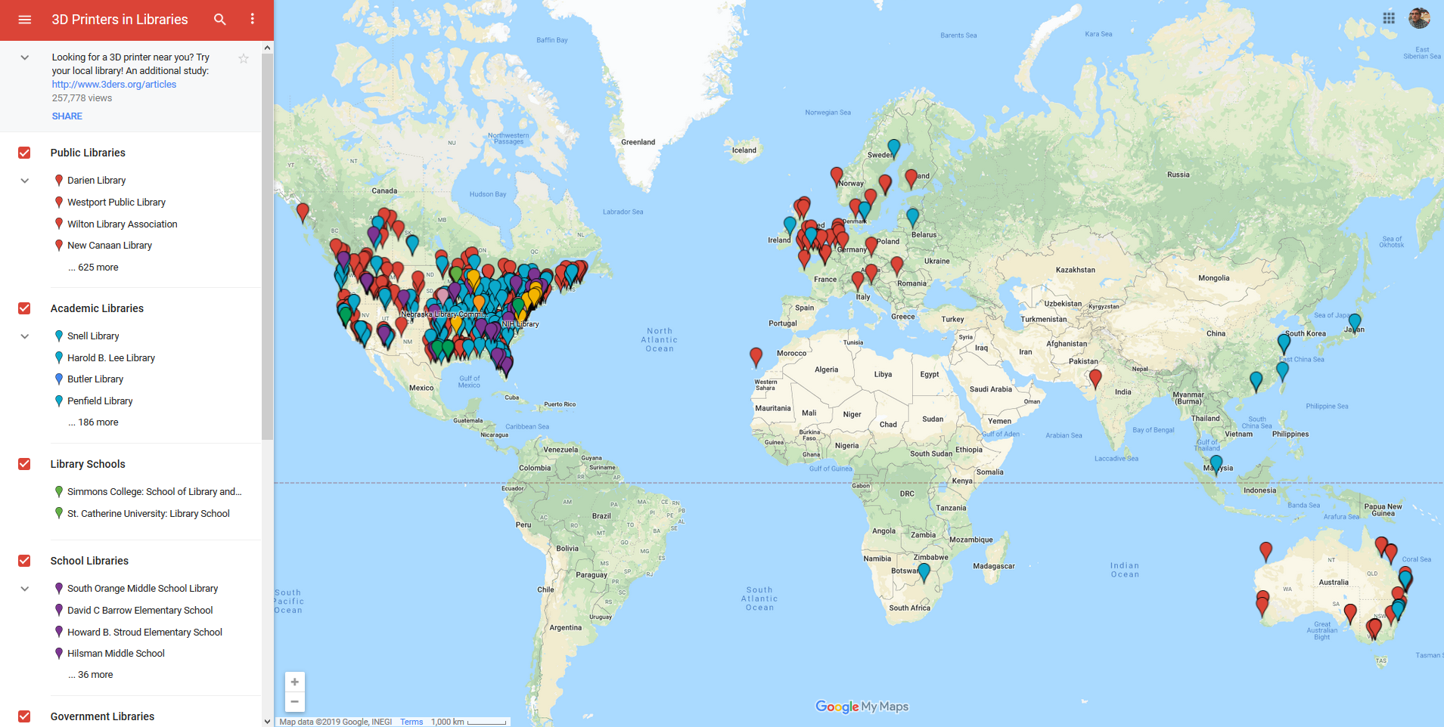
Source: https://www.3dprintingmedia.network/800-registered-3d-printers-in-libraries/

Slide 17
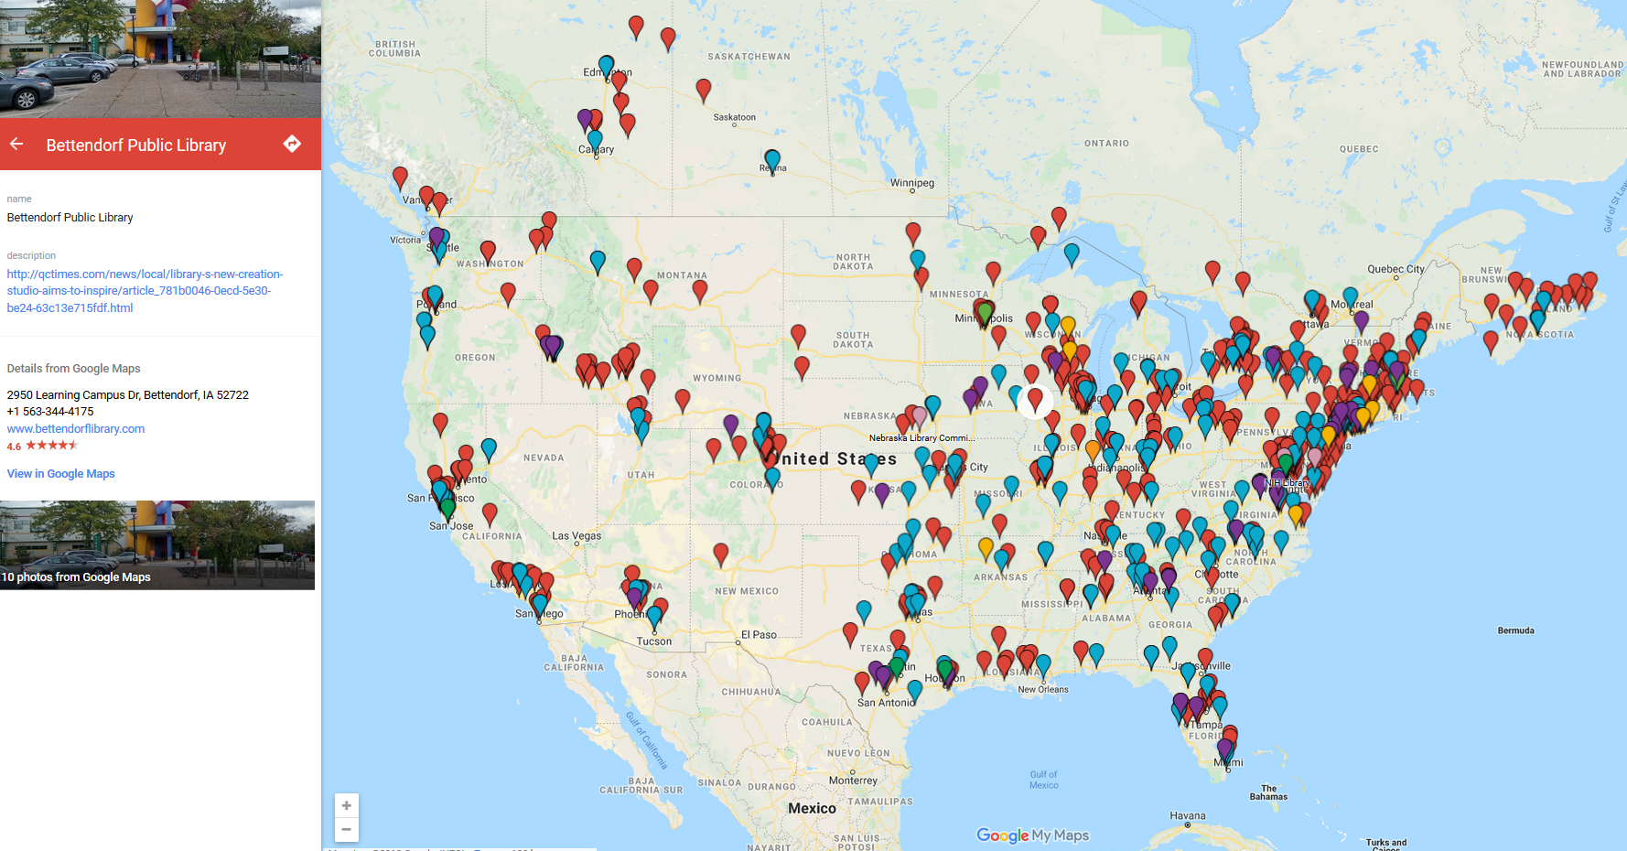

Slide 18
https://www.3dprintingmedia.network/800-registered-3d-printers-in-libraries/

Slide 19
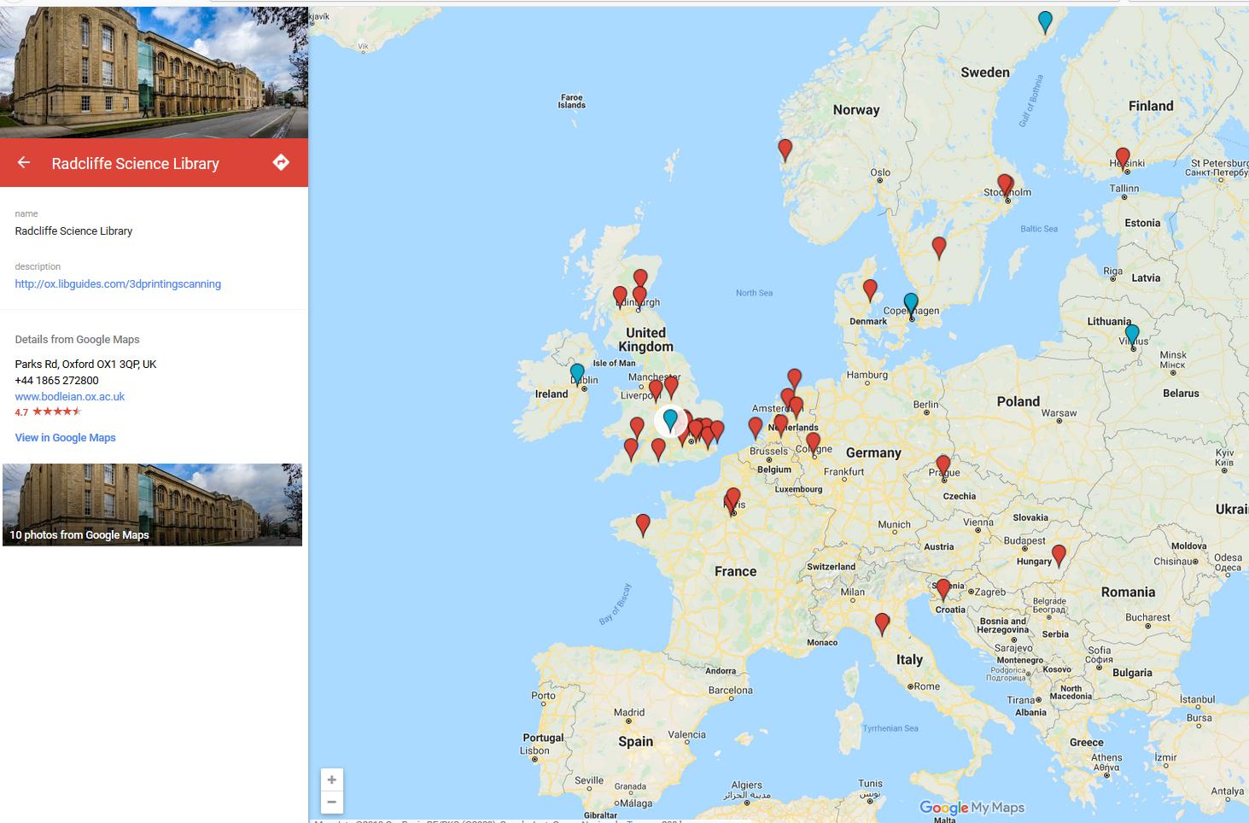
Source: https://www.3dprintingmedia.network/800-registered-3d-printers-in-libraries/

Slide 20
Technological and 3d printing librarians references

Slide 21
Technological references:
https://engineeringproductdesign.com/rapid-prototyping-process-selection-key-factors/
https://www.3dhubs.com/guides/3d-printing/#basics
https://www.simplify3d.com/support/materials-guide/properties-table/
https://www.3dhubs.com/knowledge-base/fdm-3d-printing-materials-compared/#methodology
https://www.simplify3d.com/support/print-quality-troubleshooting/
https://www.simplify3d.com/support/articles/working-with-file-types/
https://rigid.ink/blogs/news/the-ultimate-3d-printing-glossary
https://www.3dhubs.com/knowledge-base/definitive-3d-printing-glossary/
https://all3dp.com/3d-printing-file-formats/
https://all3dp.com/1/stl-repair-stl-file-online-checker-fix-3d-model/
https://rigid.ink/blogs/news/optimum-infill
https://www.simplify3d.com/support/print-quality-troubleshooting/
https://rigid.ink/pages/ultimate-troubleshooting-guide
https://all3dp.com/2/fdm-3d-printing-post-processing-an-overview-for-beginners/

Slide 22
Librarians references:
(20) https://www.webjunction.org/news/webjunction/3D_Printer_Revolution.html
(21) https://new.library.arizona.edu/visit/print/3D
(22) https://americanlibrariesmagazine.org/blogs/the-scoop/3d-printing-and-libraries/
(23) https://all3dp.com/2/3d-print-in-a-library-what-to-consider-how-to-find-them/
(24) http://www.ala.org/advocacy/intfreedom/3d_printer_policy
(25) https://www.3dprintingmedia.network/800-registered-3d-printers-in-libraries/
(26) http://hq.yalsa.net/programs/3724/3d-printer-clubs-and-student-leadership-opportunities
(27) Progress in the Making, 3D Printing Policy Considerations through the Library Lens, Charlie Wapner,
Oitp Perspectives, nº 3, January 2015.
(28) https://www.thingiverse.com/groups/3d-printers-in-libraries
(29) 3D Printing in Libraries Is Not About 3D Printing, Jeffrey Lancaster, Strategic Library, Issue 3, March 2014
(30) Library 3.0: How 3D Printing is Helping Reshape the Library to a Lab, By Lizabeth Arum, October, 2017
(31) Time to Adopt: Librarians’ New Skills and Competency Profiles, Birgit Schmidt, Pascal Calarco, Iryna Kuchma,
Kathleen Shearer, Positioning and Power in Academic Publishing: Players, Agents and Agendas, Conference Paper
June 2016, DOI: 10.3233/978-1-61499-649-1-1
(32) 21st Century Competencies, Winter 2016 Edition, foundation document for discussion.

Slide 23
(33) Maker Competencies and the Undergraduate Curriculum, LG-97-17-0010-17 - University of Texas at
Arlington Libraries, 2017
(34) Tinkering with Teachers: The Case for 3D Printing in the Education Library, Rachael Elrod, University of
Florida, Gainesville, FL, Education Libraries, 39:1, 2016
(35) https://www.webjunction.org/news/webjunction/3D_Printer_Revolution.html
(36) Progress in the Making Librarians’ Practical 3D Printing. Questions Answered, Zach Lichaa and Charlie
Wapner, May 2016. American Library Assotiation
(37) https://er.educause.edu/articles/2014/10/making-it-real-3d-printing-as-a-library-service
(38) Librarians as Makers, Beth Filar Williams & Michelle Folkman, Pages Journal of Library Administration
Volume 57, 2016 - Issue 1
Competencies for Information Professionals in Learning Labs and Makerspaces, Kyungwon Koh, June Abbas , https://doi.org/10.3138/jelis.56.2.114, Journal of Education for Library and Information Science, Vol. 56, No. 2
Digital Design and 3D Printing in Technology Teacher Education, Igor Vernera, Amir Merksamer, Procedia CIRP, Volume 36, 2015, Pages 182-186.
ABC and 3D: opportunities and obstacles to 3D printing in special education environment, Erin Buehler Shaun K. Kane, Amy Hurst, Proceeding ASSETS '14 Proceedings of the 16th international ACM SIGACCESS conference on Computers & accessibility, Pages 107-114, 2014. doi>10.1145/2661334.2661365

Slide 24
(42) https://www.torontopubliclibrary.ca/using-the-library/computer-services/innovation-spaces/3D-design-print.jsp
(43) https://www.rplmn.org/services/computers-equipment/3d-printer/3d-printing-procedure
(44) Job and Skills, https://study.com/articles/3d_printing_technician_salary_training_job_description.html
(45) Materilice Skills, https://i.materialise.com/blog/en/5-skills-to-help-you-begin-3d-printing-today/
(46) https://grabcad.com/groups/3d-printing-group/discussions/what-skills-are-needed-to-be-a-3d-printing-technician
(47) Developing a Pre-engineering Curriculum for 3D Printing Skills for High School Technology Education. Yu-Hung Chien
National Taiwan Normal University, TAIWAN. EURASIA Journal of Mathematics Science and Technology Education,
2017, 13(7):2941-2958. DOI 10.12973/eurasia.2017.00729a
(48) Making It Real: 3D Printing as a Library Service, Tod Colegrove , 2014, EDUCAUSE Review.
https://er.educause.edu/articles/2014/10/making-it-real-3d-printing-as-a-library-service
(49) 3D Printing: A Practical Guide for Librarians, Sara Russell Gonzalez, Denise Beaubien Bennett, Rowman & Littlefield,
2016. ISBN 9781442255494.
(50) 3-D Printers for Libraries, Jason Griffey, Chicago American Library Association, 2014, ISBN 9780838959305
(51) Survey of 3D Printing in the Library, Primary Research Group. ISBN 9781574402803
3D Printing in Medical Libraries. A Crash Course in Supporting Innovation in Health Care. Jennifer Herron. 2019.
ISBN 9781538118795

Slide 25
Notes:

